Slide 1

Introduction to IT Payoff
“Show me”

Slide 2


IT Payoff: A Dialog
A Dialog
  Bob Graham (CIO)
    :Request approval for a $14M IT investment
    :Not to show ROI, but to talk Intangibles
    :Why we need to justify IT investment??
  Pat Donahue (CEO)
    :Concerned with ROIs
    :Strategic IT investment, but …
    :Board members’ question
    :Capital expenditure proposals of CAM, CRM

Slide 3



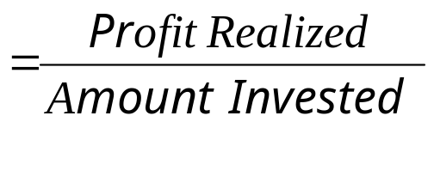
IT Payoff: A Dialog
How has IT helped biz productivity, profit, or added value to customers?
IT Payoff
  after missing an important appointment
  Higher stakes in Biz
    : DO NOT BUY, “It would be nice to have new IT”
    : JUSTIFY THE EXPENSE !!
Looking for ROI

Slide 4
IT Payoff: A Dialog
Clients will ask for projected benefits to justify the expense
  Intel, Cisco, SAP, Oracle, …
  http://www.ism.co.at/analyses/ERP/Justify_ERP_Invest.htm
  http://www.oracle.com/us/solutions/cloud/platform-as-a-service/quanitify-value-of-casb-wp-3497489.pdf
Same scrutiny as other investment is needed

Slide 5
Reasons for IT Payoff Measurement
Unconvinced manager may ask:
  - How will one know if and when the payoff realized?
  - How do we know if there’s payoff at all?
REASON 1: Competing investments
  Optimally allocate financial and people resources to all areas of the Biz
  Stronger voice of revenue-producing functions than support functions
    ex) high-precision machine vs. ERP Upgrade

Slide 6

Reason for IT Payoff Measurement
REASON 2: Duration of Payoff
  How long it will take to see ROI?
  Seek near-term profitability
  IT tends to have less apparent and longer payoff duration
Hard to justify!

Slide 7
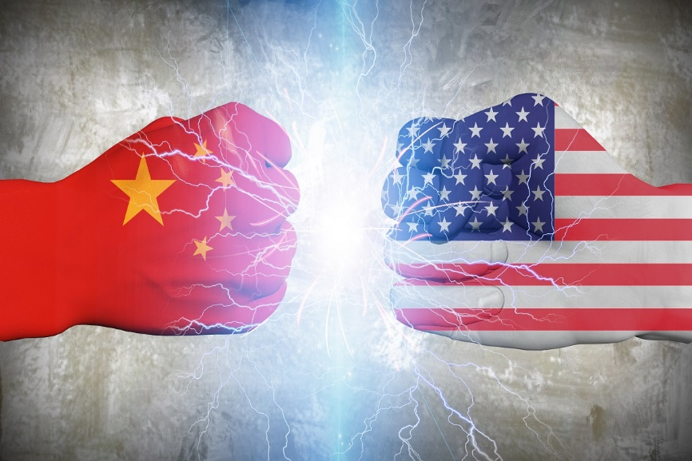

Reason for IT Payoff Measurement
REASON 3: Overall Economic Picture
  https://www.cio.com/article/2429865/enterprise-resource-planning/enterprise-resource-planning-10-famous-erp-disasters-dustups-and-disappointments.html
  2007 Financial Crisis, 2016 Age of low growth and Unemployment, 2017 President D. Trump, 2019 trade War between U.S and China,COVID-19,…
  Closer scrutiny of the payoff expected

Slide 8
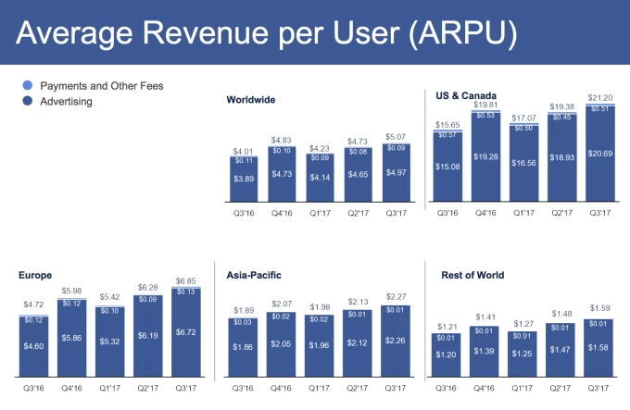
IT Investment measurement
Profitability
  C/B analysis(NPV)
  ROI(IRR)

Slide 9
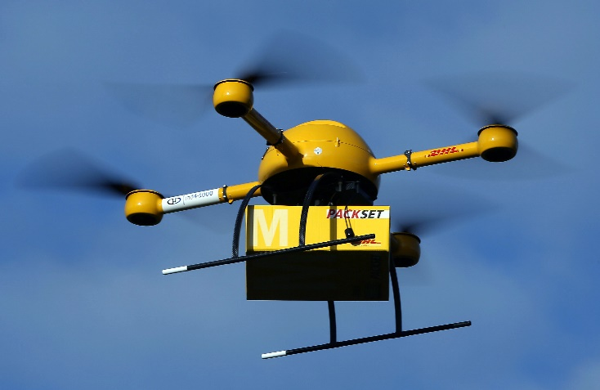
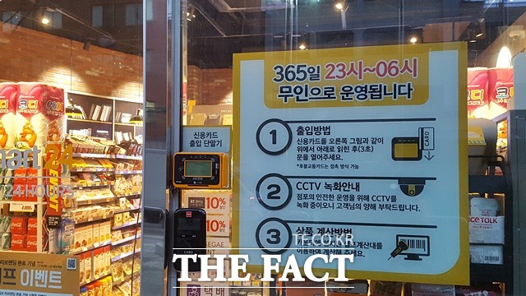
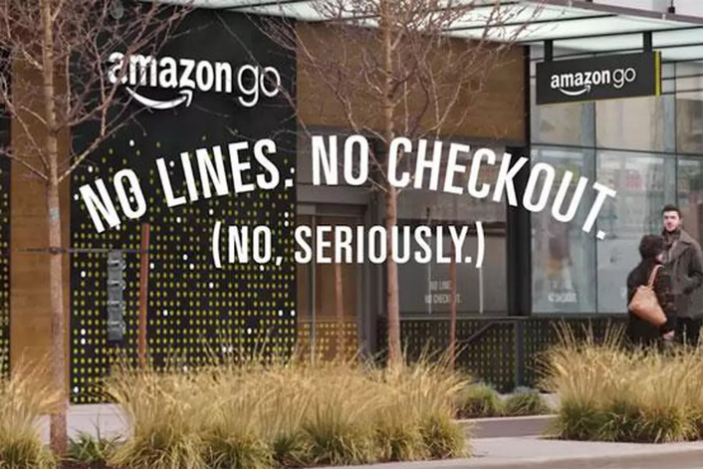
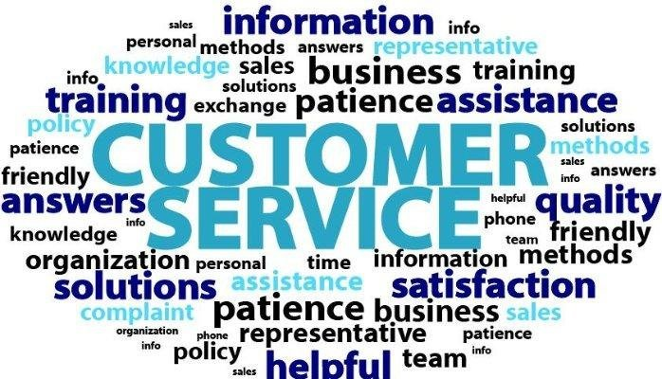
IT Investment measurement
Productivity
  Efficiency
  Quality
Customer Value
  Greater Loyalty & long-term retention

Slide 10



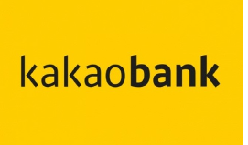



IT Payoff : A Case
Kakao Services
Walmart Inventory Mgmt. System

Slide 11

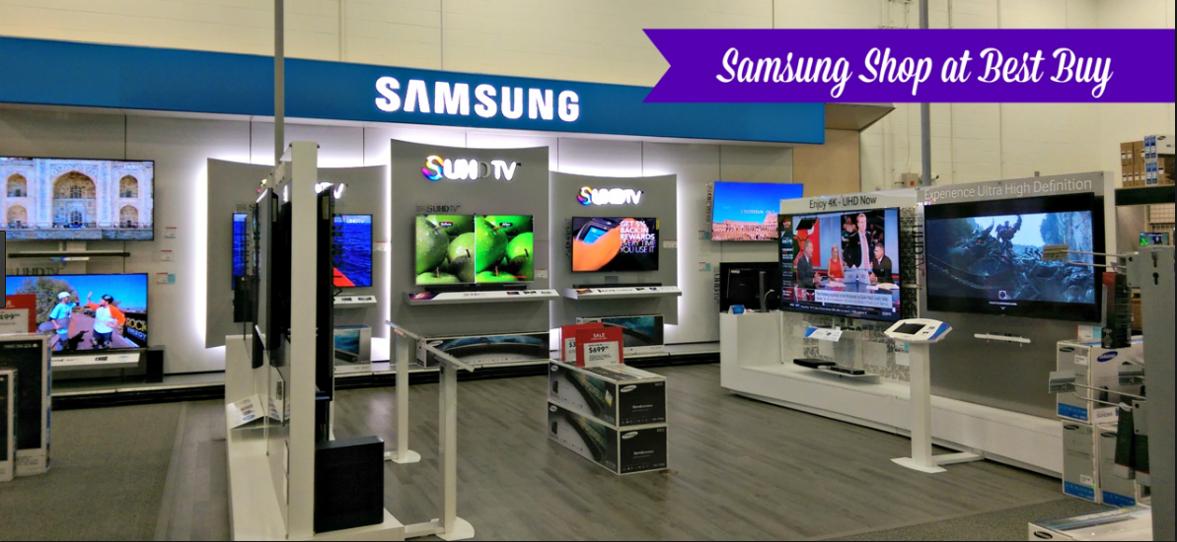
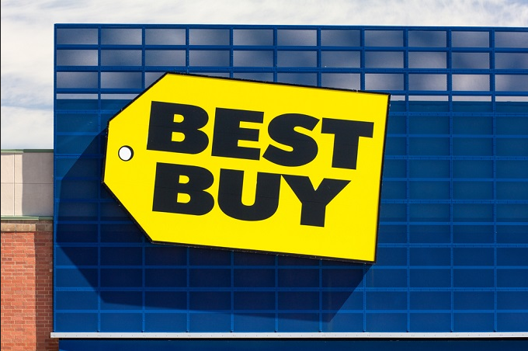
IT Payoff : A Case
Regulations
  Digital TV
Productivity Paradox
  “We see computers everywhere except in the productivity statistics”

Slide 12
The IT Payoff Paradox
Paradox : A statements that is seemingly contradictory or opposed to common sense and yet is true.

Slide 13
Inconclusive nature of IT payoff
  “D-TV investment” Who enjoys the fruits?
  Arno Penzias stated, “negative effects from IT, and also successful NY MTA case”
  IT Investment: 45% of all capital Exp.
  High profile disasters in IT
Open debate on “IT productivity paradox”

Slide 14
Factors of IT paradox
Anecdotal evidence
  Generalization errors
  Hershey(Fatal Failure), …
  IBM(Big Success), …
A Snapshot View
  “It takes time” → Time lags
  Learning and adaptation occurs
  “Hang in there until the creases are ironed out”

Slide 15
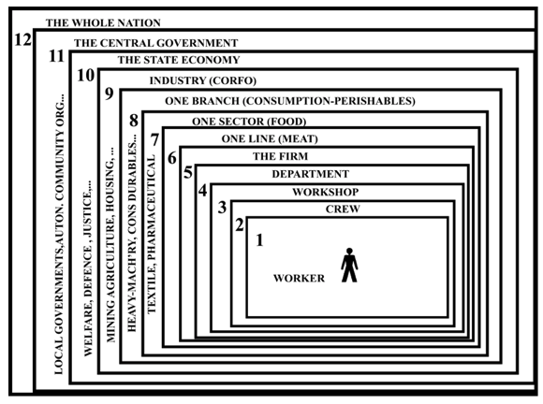



Factors of IT paradox
Isolating the IT effect
  Protech solution case
    35% increase in # of orders
    85% revenue increase
  Will Management buy it?
  How to isolate IT effect? .. Not an easy answer
Level of Analysis
  Economy : negative??
  Industry : mixed ??
  Firm : positive??

Slide 16
Factors of IT paradox
Aggregated Analysis
  IT is implemented at a process level, however, we look at the organizational level!
Complementary Factors
  To realize maximum benefit from IT
    Not only investment in IT,
    but also IT-driven reengineering
  ERP & BPR

Slide 17
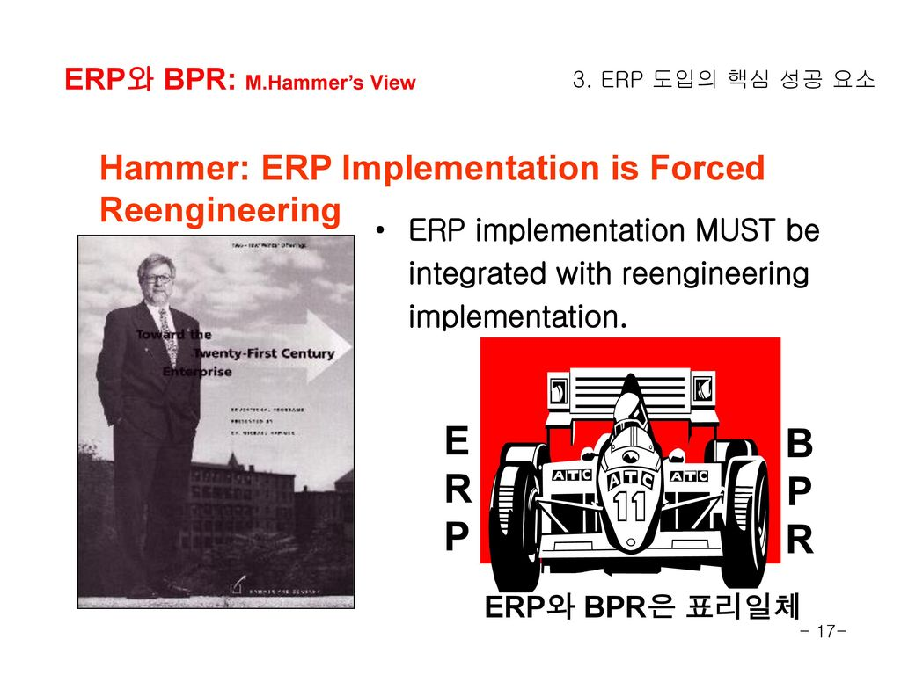
Factors of IT paradox
Aggregated Analysis
  Process level implemented, but org. level evaluated
  Process view (How IT creates Biz value)
    Proper assets proper impacts
    org. improvements
Complementary Factors
  Business value complementarity
  IT investment and Reengineering
&

Slide 18
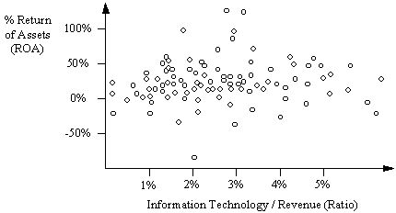
Paradox still exist?
Two Views
  Paradox is history
  IT has failed to lift productivity growth throughout the economy
We need to learn lessons from this debate

Slide 19
Beyond the paradox
Positive side of the debate
  Realization of the issues and inter- connection with payoff
  Under more scrutiny than ever
Robert Solow’s words
New paradox emerging
Issues forefront
  Objectives set up front
  Time-based criteria established

